Slide 1
Red, Cedar and Kenny
Three Notable Pianists of the Jazz Pianists Canon

Slide 2
Red, Cedar and Kenny
What can lead a jazz pianist to be included with the greats?
How many recordings they made as a leader
How many recordings they made as a sideman
(particularly if with notable leaders)
They have been on recordings of major record labels
What they have contributed musically (improvisation and comping styles)
They are found in books, trade magazines, articles or interviews
Studies have been done about them (e.g., dissertations)
Enough time has passed for their inclusion in the jazz pianists canon

Slide 3
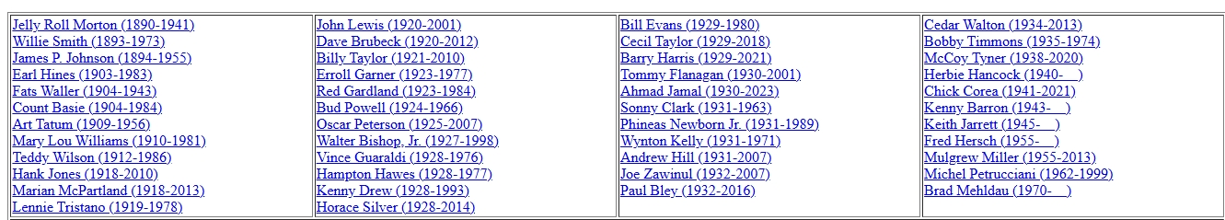
Red, Cedar and Kenny
A snapshot of some of the greatest jazz pianists:

Slide 4
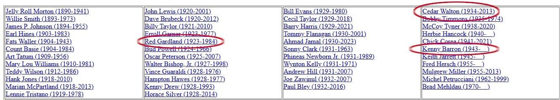
Red, Cedar and Kenny
A snapshot of some of the greatest jazz pianists:

Slide 5
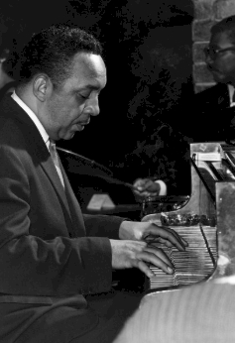
Red, Cedar and Kenny
Red Garland:
Toured with trumpeter Hot Lips Page’s band
Released 25 albums on Prestige Records, as well as several for the Riverside Records subsidiary Jazzland
Known for his use of block chords, also known as the locked-hands style
Left-hand often plays accompanying hits on
and-of-2 and and-of-4
References pianist Ahmad Jamal in his playing
(1923 – 1984)

Slide 6
Red, Cedar and Kenny
Red Garland:
Recorded approximately 45 albums as a leader, and 25 albums as a sideman
Most notable for his time playing with the Miles Davis Quintet during the years 1955-1958
Most associated with the Hard bop style
(1923 – 1984)

Slide 7
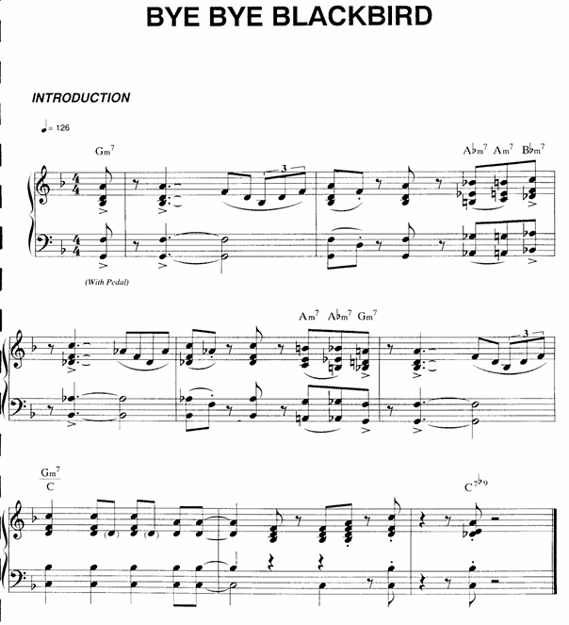
Red, Cedar and Kenny
Red Garland:
Intro to “Bye, Bye Blackbird” (1957):

Slide 8
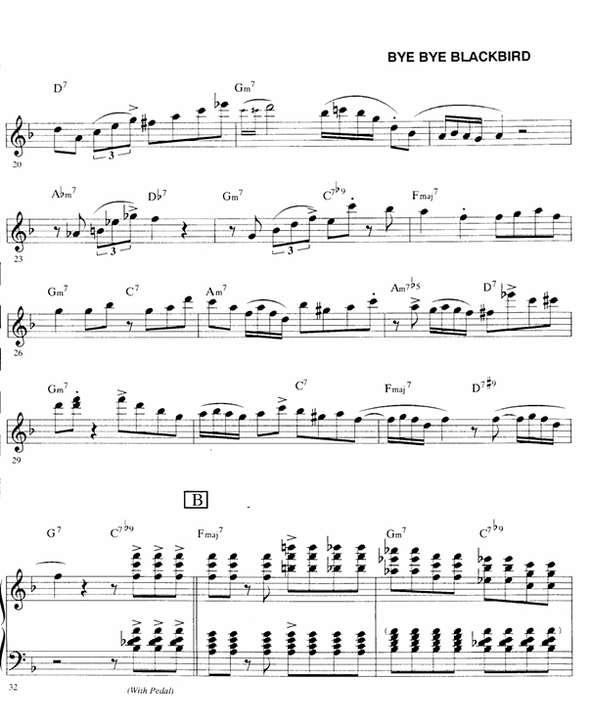


Red, Cedar and Kenny
Red Garland:
Piano solo on “Bye, Bye Blackbird” (1957):

Slide 9
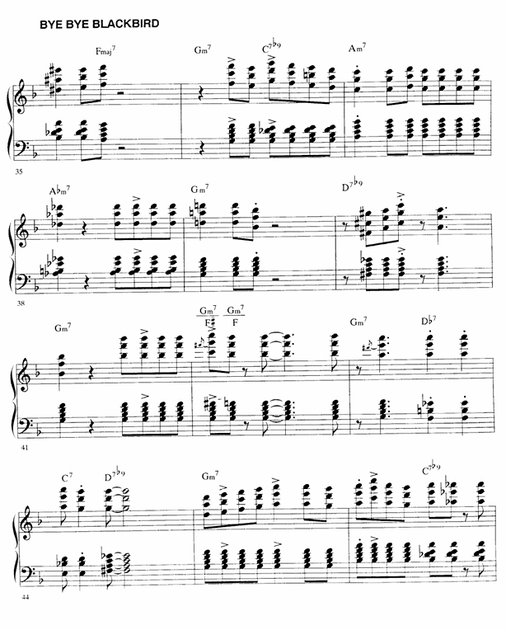
Red, Cedar and Kenny
Red Garland:
Piano solo on “Bye, Bye Blackbird” (1957):

Slide 10
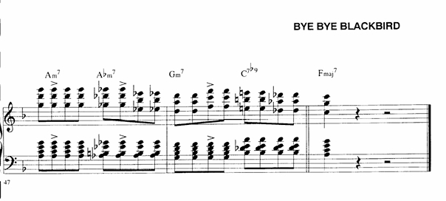
Red, Cedar and Kenny
Red Garland:
Piano solo on “Bye, Bye Blackbird” (1957):

Slide 11

Red, Cedar and Kenny
Cedar Walton:
Cited Nat King Cole, Bud Powell, Thelonious Monk and Art Tatum as his major influences
Notable for his time playing with drummer Art Blakey’s Jazz Messengers group of the early 1960s
An accomplished composer, including Bolivia, Mosaic, Mode for Joe, and Firm Roots
From the Hard bop style
Known to have recorded approximately 48 albums as leader or co-leader, and approximately 158 albums as a sideman
(1934 – 2013)

Slide 12
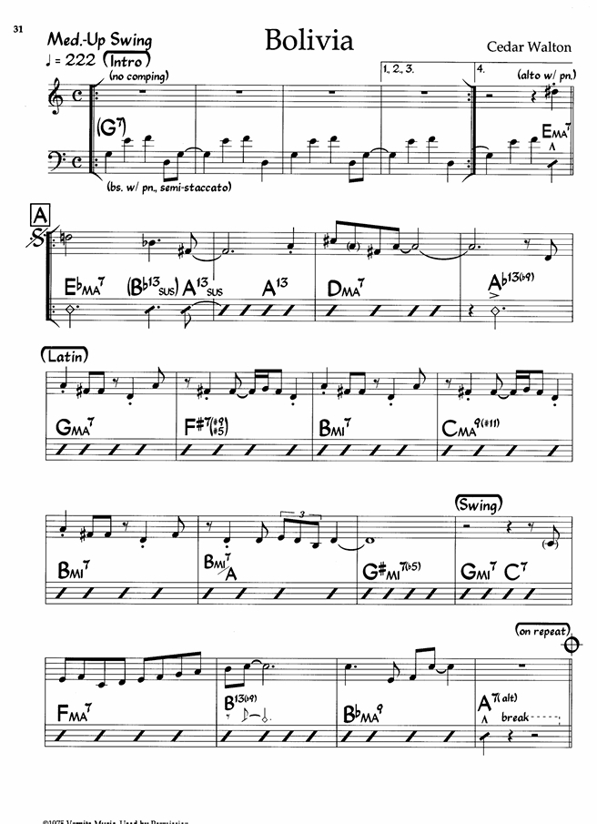
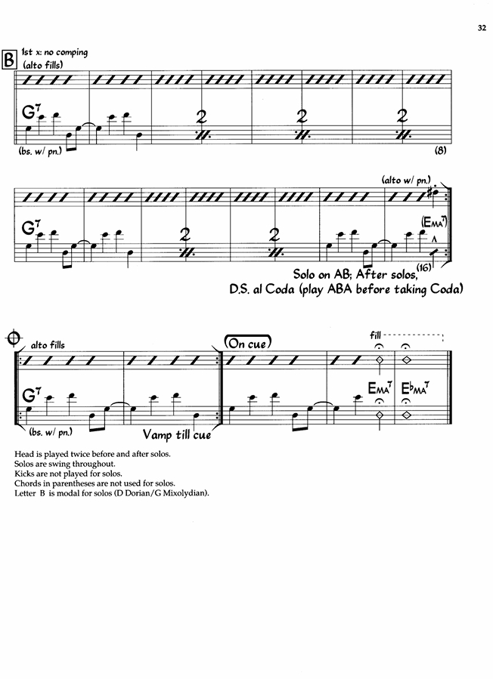
Red, Cedar and Kenny
Cedar Walton:
(1934 – 2013)

Slide 13
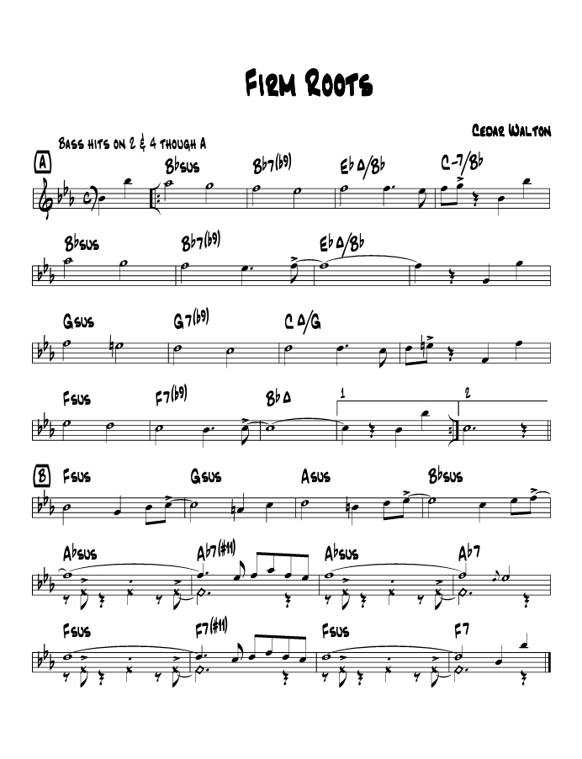
Red, Cedar and Kenny
Cedar Walton:
(1934 – 2013)

Slide 14

Red, Cedar and Kenny
Kenny Barron:
While in school, played with saxophonist Jimmy Heath
Cites pianists Hank Jones and Tommy Flanagan as his principal influences
Joined Dizzy Gillespie’s band at the age of 19 and toured between 1962 and 1966
Co-led the group Sphere, a group dedicated to performing the music of Thelonious Monk
To date, has recorded approximately 56 albums as leader or co-leader, and approximately 325 albums as a band member or sideman
(1943 - )

Slide 15
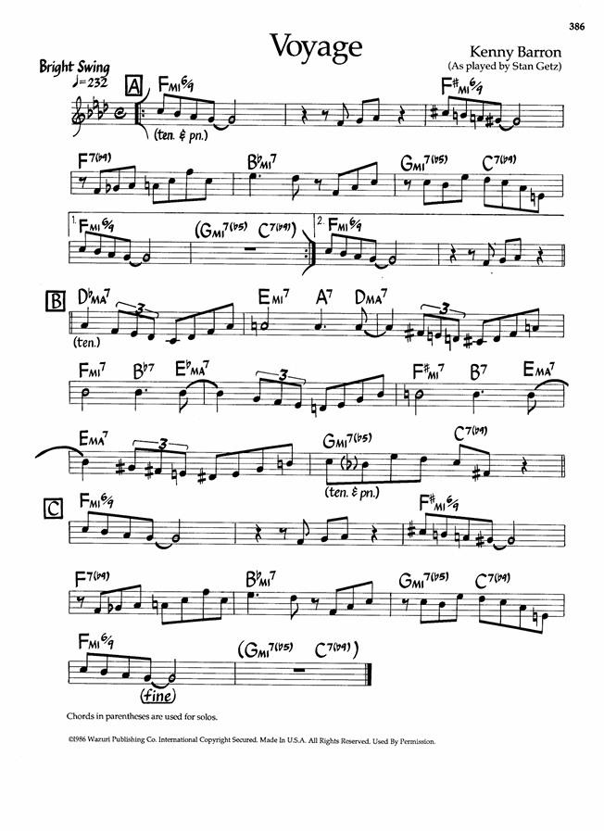
Red, Cedar and Kenny
Kenny Barron:
(1943 - )

Slide 16
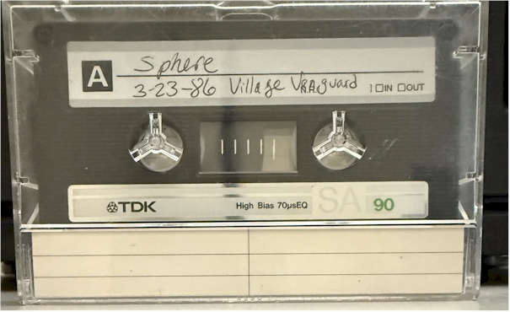
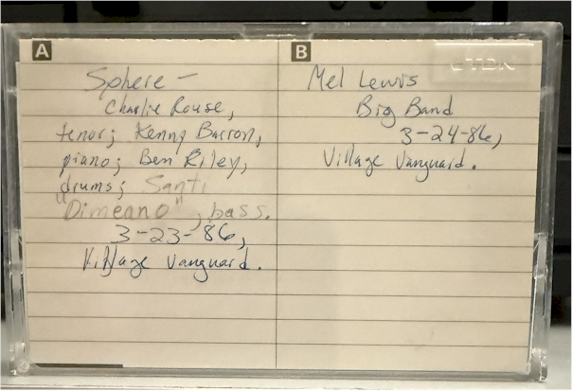
Red, Cedar and Kenny
Kenny Barron:
(1943 - )

Slide 17
Red, Cedar and Kenny
Three Notable Pianists of the Jazz Pianists Canon

